Slide 1

OpenPMU Technology Platform for Synchrophasor Research Applications
Or how I learned to stop worrying and love IEEE C37.118.1-2011

Slide 2

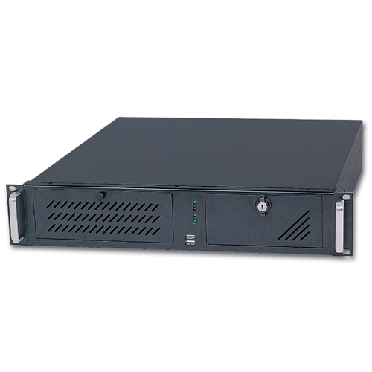
Why build an Open Source PMU?
Or why not use one of the many commercial PMUs on the market….

Slide 3

Why build an Open Source PMU?
Or why not use one of the many commercial PMUs on the market….

Slide 4

Why build an Open Source PMU?
Or why not use one of the many commercial PMUs on the market….

Slide 5
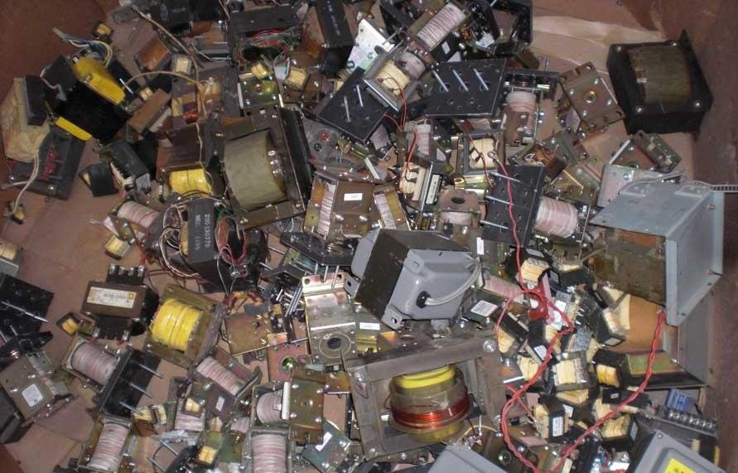
Why build an Open Source PMU?
Or why not use one of the many commercial PMUs on the market….

Slide 6
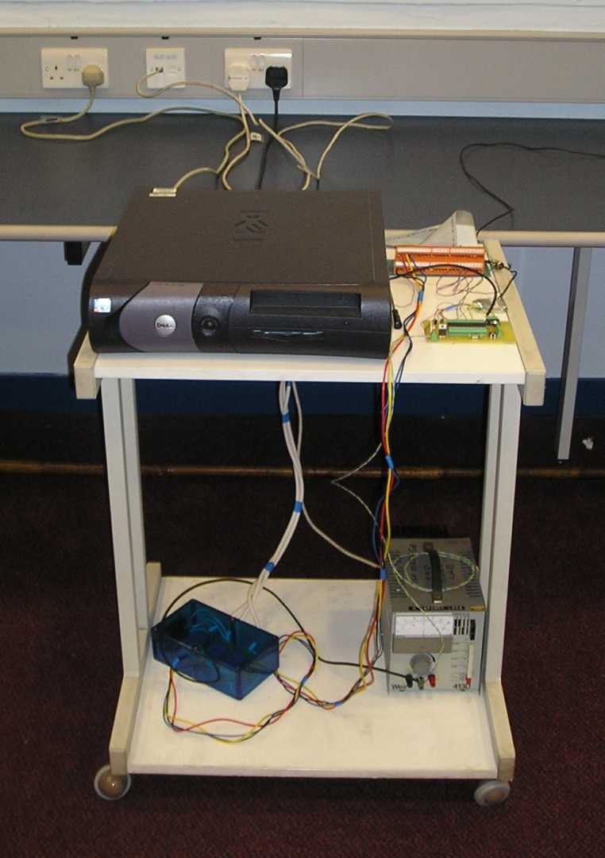
Why build an Open Source PMU?
V1

Slide 7
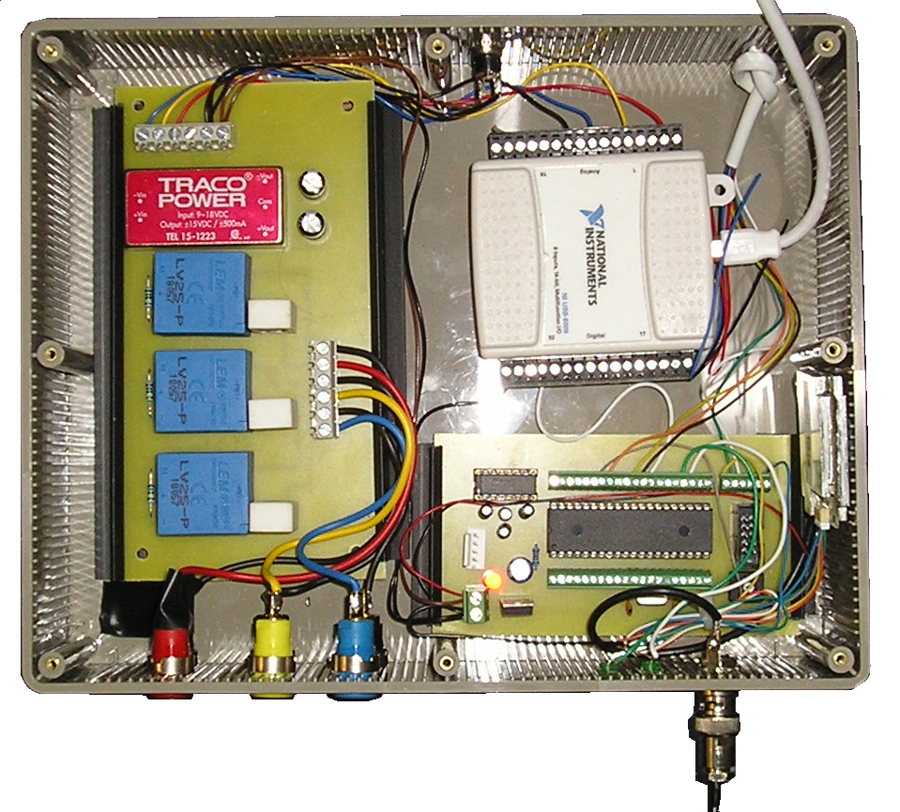
Why build an Open Source PMU?
V2

Slide 8
How does it work?
Measurement
Phase Estimation
Telecoms
Transient Detection
Voltages Currents
Local Storage
IEEE C37.118.2 Synchrophasor

Slide 9
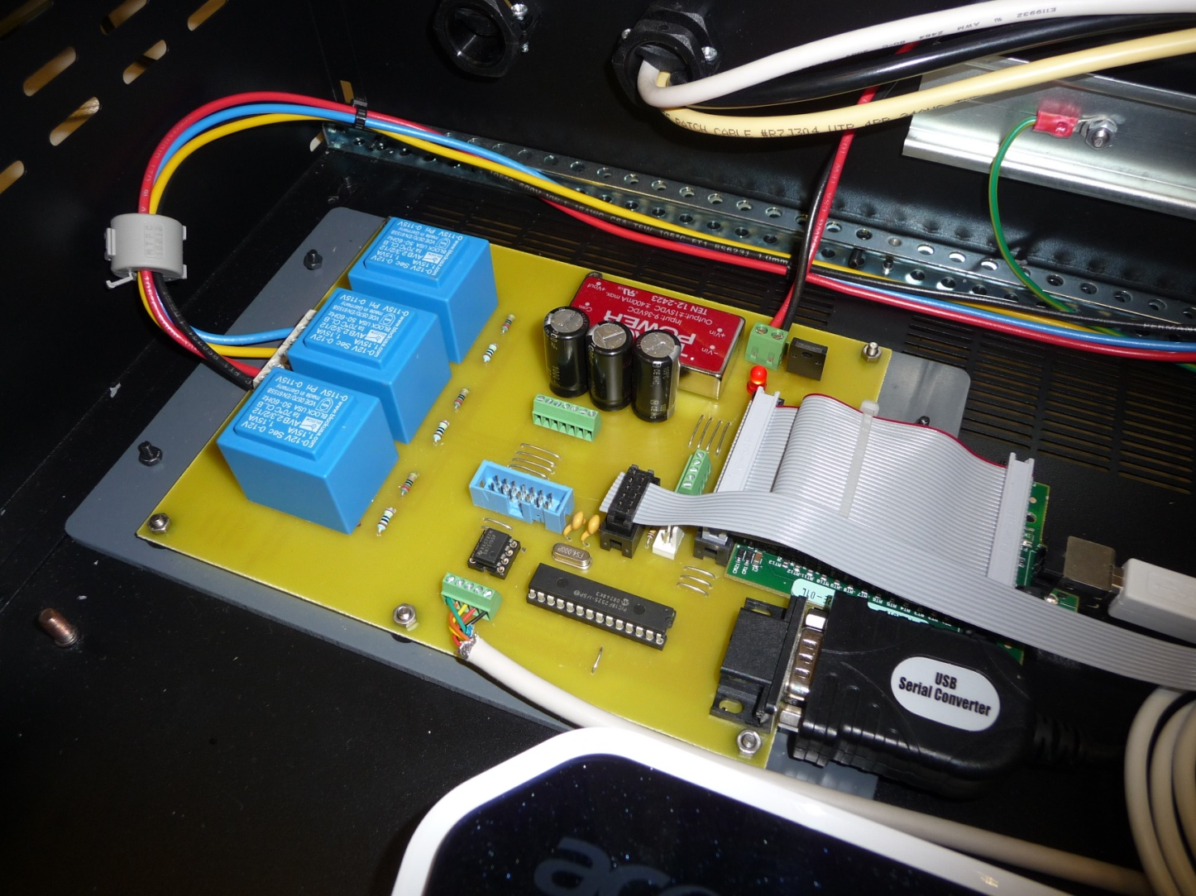
How does it work?

Slide 10
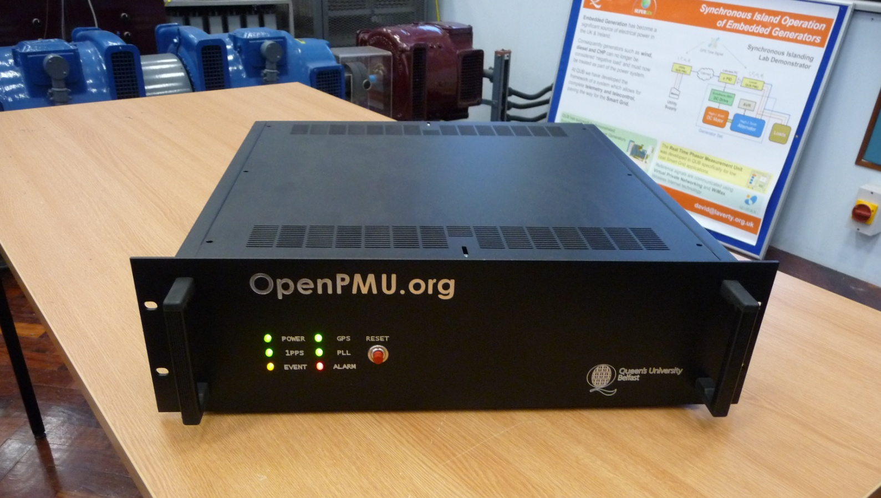
How does it work?

Slide 11
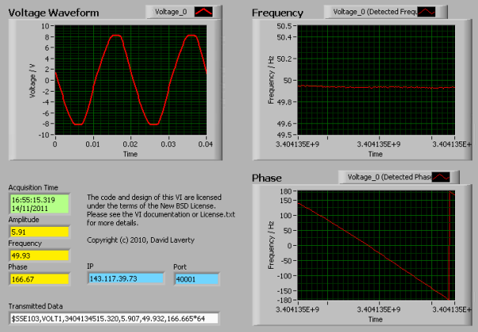
How does it work?

Slide 12
How well does it work?

Slide 13
How well does it work?

Slide 14
How well does it work?

Slide 15
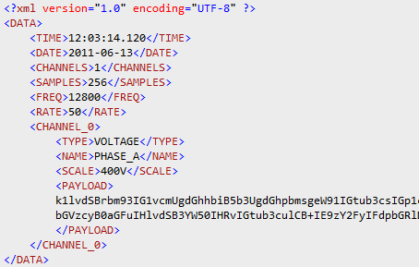
How well does it work?

Slide 16

What use is it?
7
5x Orkney, 2x Shetland
11x PMUs on GB network
2x PMUs on Shetland network
2x PMUs at QUB for development
3x PMU on All-Ireland network
Data concentrator at QUB
Pi Server for remote access / historian
1x PMU at Buncrana
1x PMU at Tappaghan 2x PMU at QUB
1x Data Concentrator at QUB
1x Tealing
2
1x Manchester
4
4x Reading & Slough
1x PMU at UCD

Slide 17
What use is it?
Anti-Islanding Detection
(Shutdown generators when grid lost)
Stability with large wind penetrations
(Ireland frequently sees 50% wind generation)
Telecoms delivery technology evaluation
(WiMAX IEEE 802.16)

Slide 18
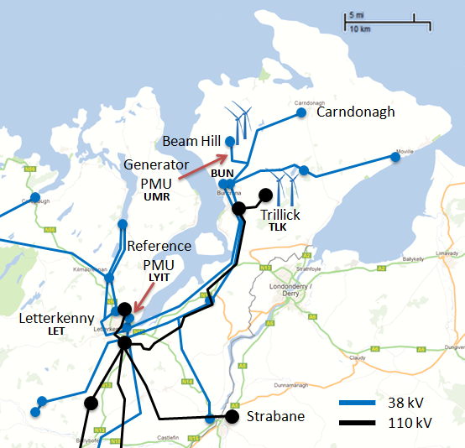
Phase variation on Wind Farm feeders
Inishowen, Co. Donegal.
The world’s 41st largest producer of wind power!

Slide 19
Phase variation on Wind Farm feeders

Slide 20
Phase variation on Wind Farm feeders

Slide 21
Phase variation on Wind Farm feeders

Slide 22
Getting involved….
Build one! Get design drawings, component listings, source code and binaries from:
www.OpenPMU.org
email me: david.laverty@gmail.com

